Slide 1
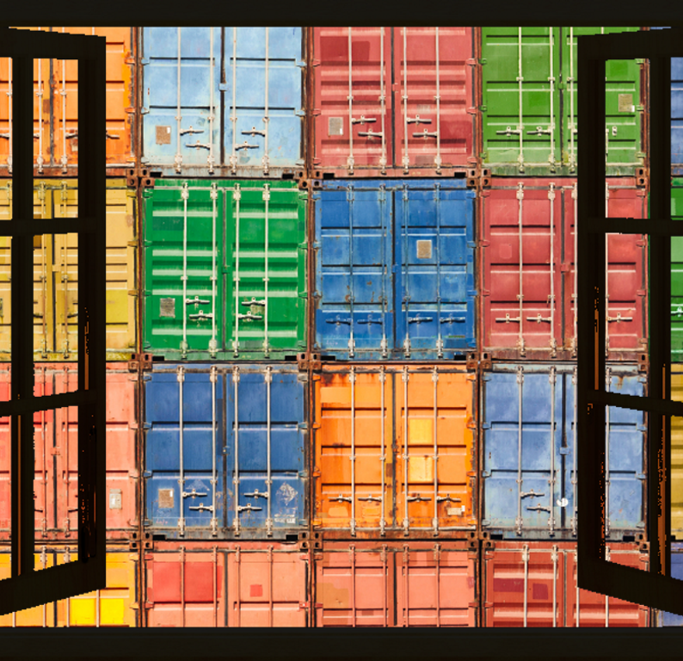
Microsoft *Application Containers for Geeks
Midwest Azure User Group
December 2016

Slide 2

Mike Nelson Infrastructure Architect – SECURA Insurance Microsoft MVP – Cloud & Datacenter Microsoft Azure Advisor Citrix CTP VMware vExpert
@nelmedia
nelmedia@gmail.com

Slide 3
Discuss
What Containers Are
Container Images
But What About…
Demo’s & Labs
Why Use Them?

Slide 4
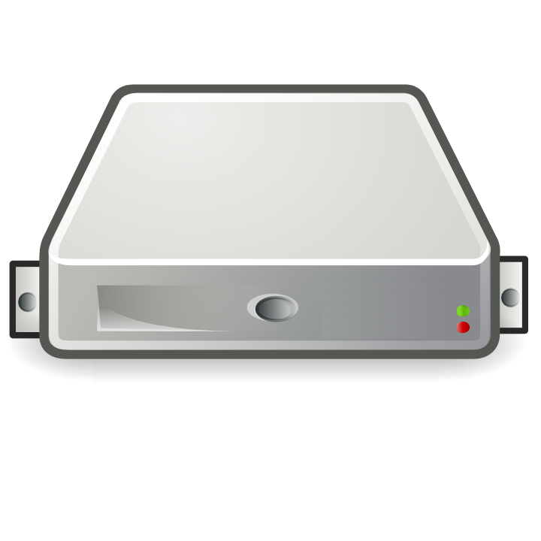
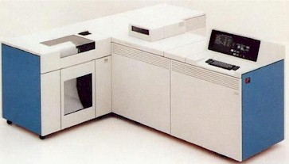
Mainframe / Mini → Server Revolution
$
$
$
$
$
$
$
$
$
$
$
$
$
$
$
$
$
$
$
$
$
$
$
$
$
$
$
$
$
$

Slide 5
Server → VM Evolution
Guest OS #5
Guest OS #6
Guest OS #7
Guest OS #8
Guest OS #5
Guest OS #6
Guest OS #7
Guest OS #8
Guest OS #5
Guest OS #6
Guest OS #7
Guest OS #8
Guest OS #5
Guest OS #6
Guest OS #7
Guest OS #8
Guest OS #5
Guest OS #6
Guest OS #7
Guest OS #8
Guest OS #1
Guest OS #2
Guest OS #3
Guest OS #4
Guest OS #1
Guest OS #2
Guest OS #3
Guest OS #4
Guest OS #1
Guest OS #2
Guest OS #3
Guest OS #4
Guest OS #1
Guest OS #2
Guest OS #3
Guest OS #4
Guest OS #1
Guest OS #2
Guest OS #3
Guest OS #4
Hyper Visor
Hyper Visor
Hyper Visor
Hyper Visor
Hyper Visor
$
$
$
$
$

Slide 6
VM → Cloud Evolvement
Guest OS #5
Guest OS #6
Guest OS #7
Guest OS #8
Guest OS #5
Guest OS #6
Guest OS #7
Guest OS #8
Guest OS #5
Guest OS #6
Guest OS #7
Guest OS #8
Guest OS #5
Guest OS #6
Guest OS #7
Guest OS #8
Guest OS #5
Guest OS #6
Guest OS #7
Guest OS #8
$
$
$
$
$
$
$
$
$
$
$
$
$
$
$
$
$
$
$
$
Guest OS #1
Guest OS #2
Guest OS #3
Guest OS #4
Guest OS #1
Guest OS #2
Guest OS #3
Guest OS #4
Guest OS #1
Guest OS #2
Guest OS #3
Guest OS #4
Guest OS #1
Guest OS #2
Guest OS #3
Guest OS #4
Guest OS #1
Guest OS #2
Guest OS #3
Guest OS #4
$
$
$
$
$
$
$
$
$
$
$
$
$
$
$
$
$
$
$
$
Hyper Visor
Hyper Visor
Hyper Visor
Hyper Visor
Hyper Visor
Notes:
Who uses public cloud?

Slide 7
Cloud → Containerization
Guest OS #2
Guest OS #2
Guest OS #2
Guest OS #2
Guest OS #2
$
$
$
$
$
Guest OS #1
Guest OS #2
Guest OS #3
Guest OS #4
Guest OS #1
Guest OS #2
Guest OS #3
Guest OS #4
Guest OS #1
Guest OS #2
Guest OS #3
Guest OS #4
Guest OS #1
Guest OS #2
Guest OS #3
Guest OS #4
Guest OS #1
Guest OS #2
Guest OS #3
Guest OS #4
Hyper Visor
Hyper Visor
Hyper Visor
Hyper Visor
Hyper Visor

Slide 8
1979 chroot Unix V7
2000 BSD Jails & Solaris Zones
2008 LXC
2006 Process Containers
2013 Docker
2016 Rocket - Photon
2016 Windows Containers
2015 Azure Containers

Slide 9


Slide 10
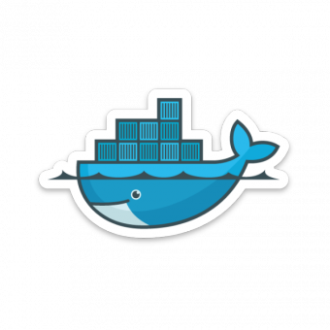
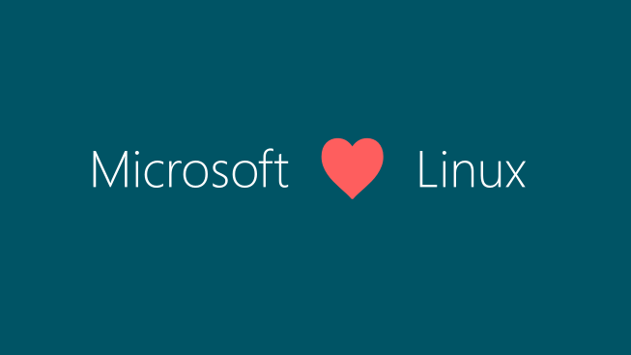


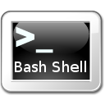
Now on GitHub!

Slide 11

Server 2016 GA!
System Center 2016 GA!
CS Docker for Server 2016 GA!

Slide 12
What is a container?

Slide 13
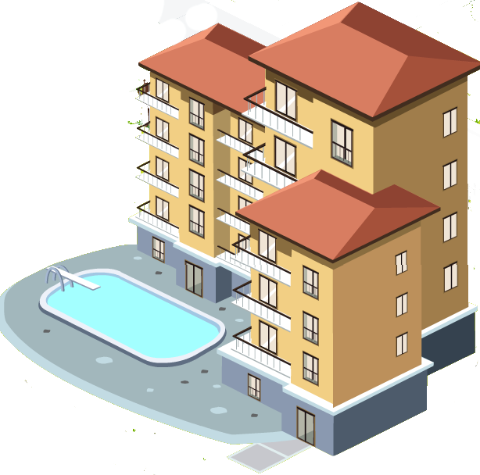

What is a container?
Will containers replace VM’s?
No.
Containers are not a virtualization technology.
They are an application delivery technology.

Slide 14
What is a container?
Application
OS
Hardware
Notes:
Traditional physical server

Slide 15
What is a container?
Traditional virtual machines = hardware virtualization
Application
VM
VM
VM
OS
Hardware

Slide 16
What is a container?
Traditional virtual machines = hardware virtualization
Application
VM
VM
VM
OS
Hardware

Slide 17
What is a container?
OS
Hardware
Traditional virtual machines = hardware virtualization
Application
VM
VM
VM
OS
Hardware

Slide 18
What is a container?
Containers = Operating system virtualization
OS
Applications
Kernel
Hardware
Traditional virtual machines = hardware virtualization
Application
VM
VM
VM
OS
Hardware

Slide 19
What is a container?
Containers = Operating system virtualization
OS
CONTAINER
CONTAINER
CONTAINER
Applications
Kernel
Hardware
Traditional virtual machines = hardware virtualization
Application
VM
VM
VM
OS
Hardware
Notes:
Real power of containers is portability, not ability to carve up OS space

Slide 20
What is a container?
Containers = Operating system virtualization
OS
CONTAINER
CONTAINER
CONTAINER
Applications
Kernel
Hardware
Traditional virtual machines = hardware virtualization
Application
VM
VM
VM
OS
Hardware

Slide 21
What is a container?
Containers = Operating system virtualization
Windows Server Containers
Maximum speed and density
OS
CONTAINER
CONTAINER
CONTAINER
CONTAINER
CONTAINER
CONTAINER
Applications
Kernel
Kernel
Hardware
Traditional virtual machines = hardware virtualization
Application
VM
VM
VM
OS
Hardware

Slide 22
What is a container?
Containers = Operating system virtualization
Windows Server Containers
Maximum speed and density
OS
CONTAINER
CONTAINER
CONTAINER
CONTAINER
CONTAINER
CONTAINER
Applications
Kernel
Kernel
Hardware
Hyper-V Containers
Isolation plus performance
Traditional virtual machines = hardware virtualization
Application
VM
VM
VM
CONTAINER
CONTAINER
CONTAINER
OS
Kernel
Kernel
Kernel
Hardware
Hyper-V

Slide 23
High Level Architecture
}
Docker Universal Control Plane
Container
Development and
Management Toolset
Docker Client
Docker PowerShell
Docker Compose
Docker Registry
Docker Swarm
Docker Engine (Hostd)
Operating System
Container Runtime

Slide 24
Windows Containers
Host User Mode
System Processes
Container Management
Session Manager
Docker Engine
Local Security Authority
Compute Services
Etc…
Windows Kernel
Hyper-V Hypervisor
Notes:
User mode = processes
Kernel mode = drivers

Slide 25
Windows Containers
Host User Mode
System Processes
Container Management
Session Manager
Docker Engine
Local Security Authority
Windows Server Container
Compute Services
Etc…
Windows Kernel
Hyper-V Hypervisor

Slide 26
Windows Containers
Host User Mode
System Processes
Container Management
Session Manager
Docker Engine
Local Security Authority
Windows Server Container
Compute Services
Etc…
System Processes
Windows Kernel
Hyper-V Hypervisor
Notes:
System processes – Why? So the container has it’s own properties – own user accounts, UI, etc. We don’t want it to know about the base accounts, etc.

Slide 27
Windows Containers
Host User Mode
System Processes
Container Management
Session Manager
Docker Engine
Local Security Authority
Windows Server Container
Compute Services
Etc…
System Processes
Application Process(es)
Windows Kernel
Hyper-V Hypervisor

Slide 28
Windows Containers
Host User Mode
System Processes
Container Management
Session Manager
Docker Engine
Windows Server Container
Local Security Authority
Windows Server Container
Compute Services
System Processes
System Processes
Application Process(es)
Etc…
Application Process(es)
Windows Kernel
Hyper-V Hypervisor

Slide 29
Windows Containers
Host User Mode
System Processes
Container Management
Session Manager
Hyper-V Container
Docker Engine
Windows Server Container
Local Security Authority
Windows Server Container
Compute Services
System Processes
System Processes
Application Process(es)
Etc…
Application Process(es)
Windows Kernel
Hyper-V Hypervisor

Slide 30
Windows Containers
Host User Mode
System Processes
Container Management
Session Manager
Hyper-V Container
Docker Engine
Windows Server Container
Local Security Authority
Windows Server Container
Compute Services
System Processes
System Processes
Application Process(es)
Etc…
Application Process(es)
Windows Kernel
Windows Kernel
Hyper-V Hypervisor

Slide 31
Windows Containers
Host User Mode
System Processes
Container Management
Session Manager
Hyper-V Container
Docker Engine
Local Security Authority
Windows Server Container
Windows Server Container
Compute Services
Etc…
System Processes
Application Process(es)
System Processes
Application Process(es)
Windows Kernel
Windows Kernel
Hyper-V Hypervisor

Slide 32
Windows Containers
Host User Mode
Virtual Machine Specifically Optimized To Run a Container
System Processes
Container Management
Session Manager
Hyper-V Container
Docker Engine
Local Security Authority
Windows Server Container
Windows Server Container
Compute Services
Etc…
System Processes
Application Process(es)
System Processes
Application Process(es)
Windows Kernel
Windows Kernel
Hyper-V Hypervisor
Notes:
Specifically built. Not managed by VMM – process only.
Reason = so we could take shortcuts – clones, shared memory, shared boot from SMB, etc.

Slide 33
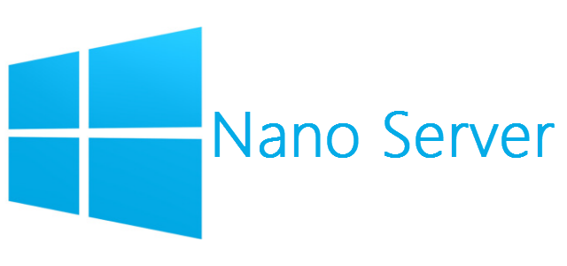
Our Journey To Nano Server – Docker CI
What is it?
Part of the Docker Project
For Every Code Submission
Compiles the change for both Linux and Windows
Uses Jenkins to execute tests against Linux and Windows hosts
Windows Server Core Image
Azure D3 VM (4 cores, 14GB RAM, 200GB SSD)
Takes ~31 min and 21 sec to run
Nano Image
Early prototype (not checked in yet)
Azure D2 VM (2 cores, 7GB, 100GB SSD)
Takes ~21min and 39 sec to run

Slide 34
Startup Performance
NodeJS with Nano Server
NodeJS with Windows Server Core
Hyper-V Container
~1.75 seconds
Windows Server Container
Under 600 Milliseconds!
Hyper-V Container
~3.3 seconds
Windows Server Container
~1 second
A virtual machine takes ~3 seconds
A virtual machine takes ~5 seconds to over a min
*Includes initial boot provisioning phase (out-of-box setup etc…)
**Startup time after initial container start.
Testing performed on HP ProLiant SL250s Gen8, E5-2600, 2 Socket, 8 Core, 128GB RAM, HP SATA SSD - results may vary based on hardware and software configurations.

Slide 35
Startup Performance
NodeJS with Nano Server
Windows Server Container
Under 600 Milliseconds!
Hyper-V Container
~1.75 seconds
A virtual machine takes ~3 seconds
NodeJS with Windows Server Core
Windows Server Container
~1 second
Hyper-V Container
~3.3 seconds
A virtual machine takes ~5 seconds to over a min

Slide 36
Density
NodeJS with Nano Server
NodeJS with Windows Server Core
Hyper-V Container
First Container ~340MB
Additional Containers ~150MB
Windows Server Container
First Container ~120MB
Additional Containers ~75MB
Hyper-V Container
First Container ~555MB
Additional Containers ~280MB
Windows Server Container
First Container ~150MB
Additional Containers ~75MB
Testing performed on HP ProLiant SL250s Gen8, E5-2600, 2 Socket, 8 Core, 128GB RAM, HP SATA SSD - results may vary based on hardware and software configurations.
Notes:
Why smaller additional container? Shared memory and processes.

Slide 37
Density
NodeJS with Nano Server
Windows Server Container
First Container ~120MB
Additional Containers ~75MB
Hyper-V Container
First Container ~340MB
Additional Containers ~150MB
NodeJS with Windows Server Core
Windows Server Container
First Container ~150MB
Additional Containers ~75MB
Hyper-V Container
First Container ~555MB
Additional Containers ~280MB

Slide 38
What is a container image?

Slide 39

Container Images
My Website
Application
IIS
Application Framework
Base Image (OS)

Slide 40
Container Images
My Website
Application
IIS
Application Framework
Image Contents
Registry
Folders and Files
HKLM
HKCU
License.txt
PerfLogs
Program Files
Base Image (OS)
HKCR
HKU
Program Files (x86)
Users
Windows

Slide 41
Container Images
Image Contents
Registry
Folders and Files
My Website
Application
HKLM
inetpub
mysite.html
IIS
SOFTWARE/mykey
Application Framework
Image Contents
Registry
Folders and Files
HKLM
HKCU
License.txt
PerfLogs
Program Files
Base Image (OS)
HKCR
HKU
Program Files (x86)
Users
Windows

Slide 42
Automated Image Building
Docker Build and Dockerfiles
Method for automated container image build
Consumed when running “docker build”
Caches unchanged commands
Integrates into Docker Hub
Examples
IIS
FROM microsoft/windowsservercore
RUN powershell –command Add-WindowsFeature Web-Server
Website
FROM iis
ADD mysite.htm inetpub\mysite.htm
My Website
IIS

Slide 43
Image Registries
What is a registry?
Stores container images
Images are Pushed into a registry
Images are Pulled from a registry
Images are Searched for within a registry

Slide 44
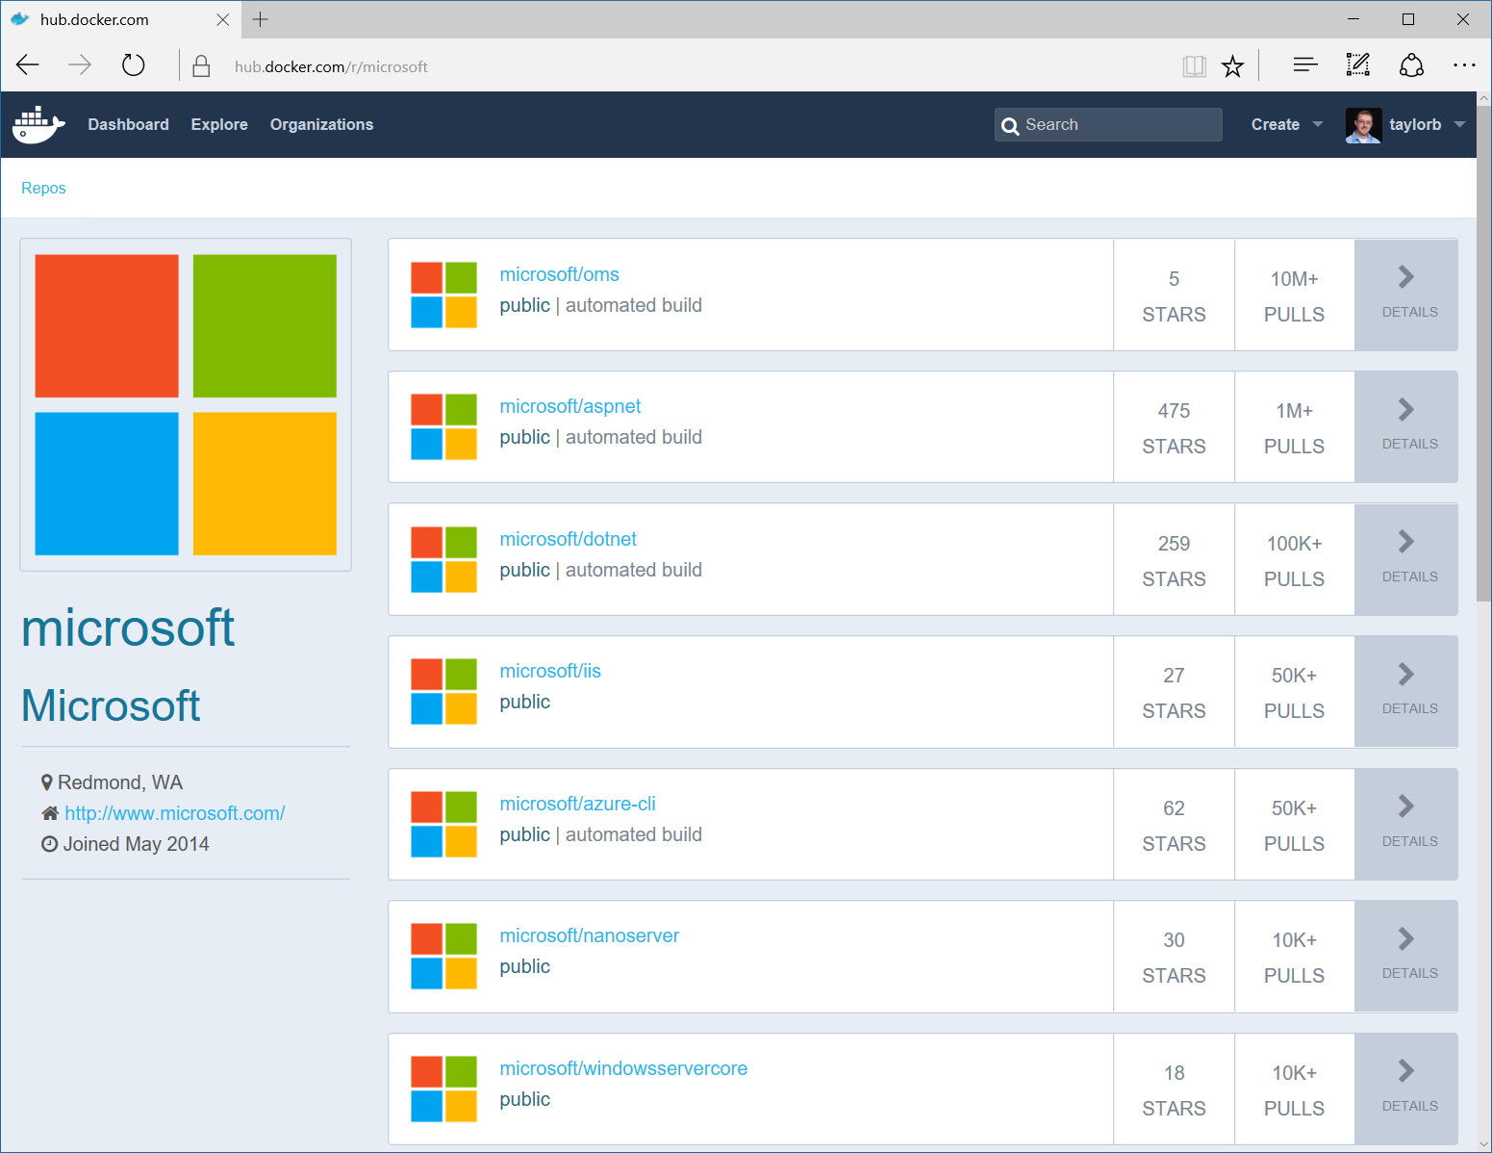
Image Registries
Docker Hub and Docker Store
Public, Official and Private image repositories
Granular access controls with organization support
Automated image build support
Docker Trusted Registry
Enterprise Grade Private Registries
Runs on your infrastructure (on-prem or cloud)
Active Directory and Role Based Access Controls
Docker Registry
Open source foundation of Hub and DTR
Runs on your infrastructure (on-prem or cloud) as a container
https://docs.docker.com/registry and or https://github.com/docker/distribution

Slide 45
Why Containers?
“It’s all about the apps.”
“Containers make it easier.”

Slide 46
How do containers make it easier?
Consistency
Efficiency

Slide 47
How do containers make it easier?
Consistency
Efficiency

Slide 48
How do containers make it easier?
Consistency
Efficiency
Rapid
Deployment
Fast Iterations
Service Separation
High Availability
Reproducibility
On Any Cloud
Scalability
Test at Scale
Immutability
Reduced Costs

Slide 49
Awareness
Design
Automate
Plan
Manage
Implement
Today’s Typical IT Services Creation Process

Slide 50

Why Containers?
Containers unlock ultimate productivity and freedom
Enable ‘write-once, run-anywhere’ apps
Can be deployed as multi-tier distributed apps in IaaS/PaaS models
Containers offers powerful abstraction for microservices
DevOps
Developers
Provide standardized environments for dev, QA, and prod
Abstract differences in OS distributions and underlying infrastructure
Higher utilization, compute density. & fast startup
Rapid scale-up and scale-down in response to changing business needs
Integrate people, process, and tools for an optimized app development process
Operations focus on standardized infrastructure
Developers focus on building, deploying and testing apps
Operations

Slide 51
Container use cases
Workload Characteristics
Scale out
Distributed
State separated
Rapid (re)start
Deployment Characteristics
Efficient hosting
Multitenancy
Rapid deployment
Highly automatable
Rapid scaling
Distributed Compute
Databases
Web
$$f\left(x\right)$$
Tasks
Scale Out

Slide 52




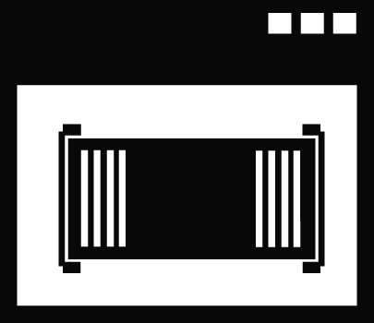

DevOps Process with Containers
Developers update, iterate, and deploy updated containers
2
3
Operations collaborates with developers to provide app metrics and insights
Developers build and test apps in containers, using development environment i.e. Visual Studio
Operations automates deployment and monitors deployed apps from central repository
1
Central Repository
2
Containers pushed to central repository

Slide 53

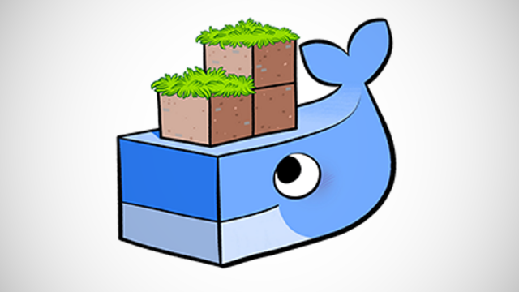
Not Into DevOps?
DNS / DHCP – Simple Services
Websites
SQL / MySQL / NoSQL / Postgres / SQLite
Dockercraft

Slide 54

But What About…

Slide 55
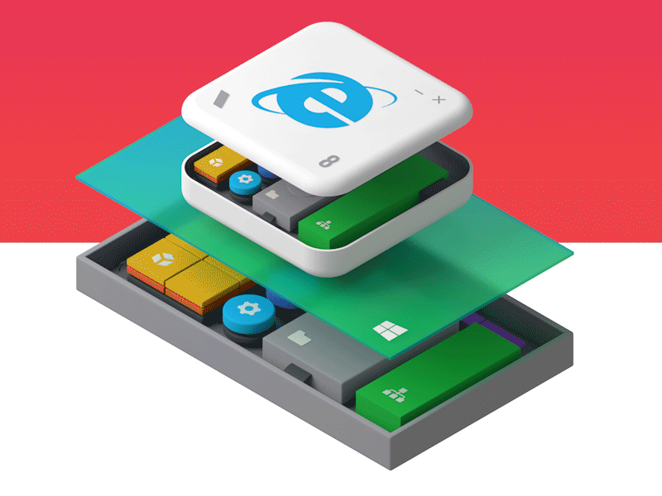
The Desktop?
Docker
Rocket
Turbo.net
Virtuozzo

Slide 56


Azure Container Service (ACS)
Streamlined provisioning of Apache Mesos Clusters
VM Scale Sets
Layered support of Swarm, Marathon, and Chronos
Docker tooling and API support
Integrated app management and scaling
Linux and Windows Server containers
Public and private cloud

Slide 57

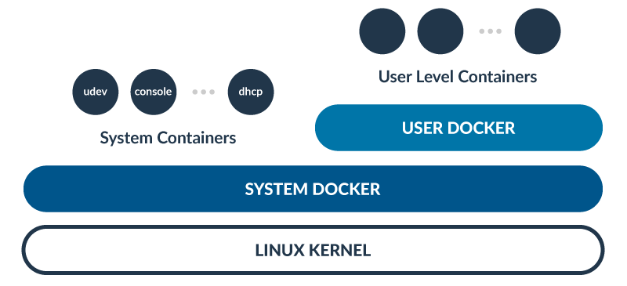

2 instances of Docker – Everything is a container

Slide 58
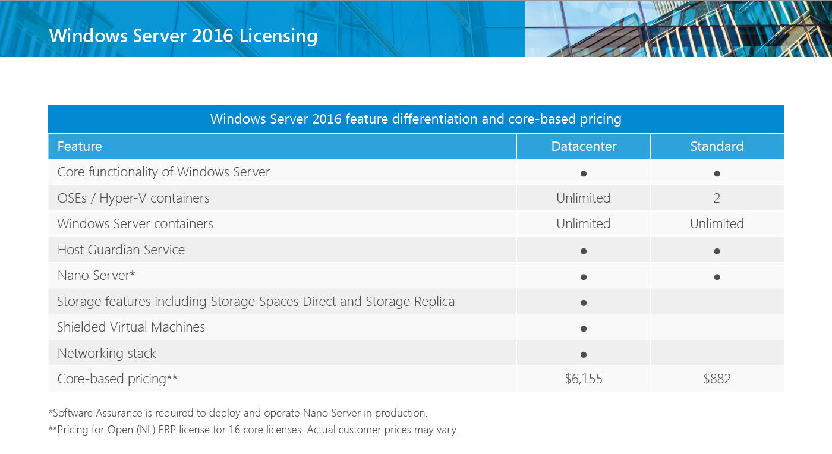
Licensing
https://www.microsoft.com/en-us/cloud-platform/windows-server-pricing

Slide 59
Patching and Updates
Update Container OS Image
Pull updated base image
Rebuild containers using dockerfiles
My Website
IIS
10.0.14393.0

Slide 60
Patching and Updates
Update Container OS Image
Pull updated base image
Rebuild containers using dockerfiles
My Website
IIS
10.0.14393.0

Slide 61
Patching and Updates
Update Container OS Image
Pull updated base image
Rebuild containers using dockerfiles
My Website
IIS
KB123456 = new image on Docker Hub
10.0.14393.0
10.0.14393.1

Slide 62
Patching and Updates
Update Container OS Image
Pull updated base image
Rebuild containers using dockerfiles
My Website
IIS
IIS
FROM windowsservercore
RUN powershell –command Add-WindowsFeature Web-Server
KB123456 = new image on Docker Hub
10.0.14393.0
10.0.14393.1

Slide 63
Patching and Updates
Update Container OS Image
Pull updated base image
Rebuild containers using dockerfiles
My Website
My Website
FROM iis
ADD mysite.htm inetpub\mysite.htm
IIS
IIS
FROM windowsservercore
RUN powershell –command Add-WindowsFeature Web-Server
KB123456 = new image on Docker Hub
10.0.14393.0
10.0.14393.1

Slide 64
Patching and Updates
Update as a new layer
Download update in container (ala run Windows Update in the container)
When container is stopped update is applied as a new layer
My Website
IIS
10.0.14393.0

Slide 65
Patching and Updates
Update as a new layer
Download update in container (ala run Windows Update in the container)
When container is stopped update is applied as a new layer
My Website
IIS
10.0.14393.0

Slide 66
Patching and Updates
Update as a new layer
Download update in container (ala run Windows Update in the container)
When container is stopped update is applied as a new layer
My Website
IIS
Same Image
10.0.14393.0
10.0.14393.0

Slide 67
Patching and Updates
Update as a new layer
Download update in container (ala run Windows Update in the container)
When container is stopped update is applied as a new layer
My Website
My Website
Same Image
IIS
IIS
Same Image
Same Image
10.0.14393.0
10.0.14393.0

Slide 68
Patching and Updates
Update as a new layer
Download update in container (ala run Windows Update in the container)
When container is stopped update is applied as a new layer
KB123456
My Website
My Website
Same Image
IIS
IIS
Same Image
Same Image
10.0.14393.0
10.0.14393.0

Slide 69
Resource Controls
CPU
Percent of host CPU container can consume
Memory
Maximum memory container can consume
Disk
Maximum IO bandwidth on the system drive
Maximum IOPs limit on the system drive
Network
Platform support for egress caps

Slide 70
Networking
Fully Manageable with Docker
Network creation/enumeration
Service Discovery
Optimized for Microsoft Cloud Stack
Advanced network policy (ACLs, QoS) can be assigned per container endpoint
Load Balancing can be handled through the Microsoft Software Load Balancer (Coming Soon)
Area of Regular and Continuous Innovation
Docker tooling support (Compose) for networking (Limited Support at GA)
Integration with other Orchestrators (Kubernetes, Swarm, etc.)
Native Overlay network driver
Multiple networks (NAT and overlay) per host

Slide 71
Storage
Container Image
Not designed for persistent data
Not designed for secrets
“Volumes”
Enables storage persistence
Enables mapping of storage into containers
Read-Only or Read/Write
Multiple containers on the same host can access the same location
Plug-In Architecture
Network Storage
Containers access SMB shares
Accessed though the containers network

Slide 72
Building a Container
Pre-built Windows Core/Nano Image
Create Container
Customize Container
Create Customized Image
Create N Containers using Customized Image

Slide 73
Image2Docker
Convert WIM/VHD to Dockerfile
Written in PowerShell
Open Source
Discover
Generate
Find Installed Programs
Show Roles & Features
IIS Sites & Configurations
Common applications
SQL, Apache
Dockerfile
https://github.com/docker/communitytools-image2docker-win

Slide 74
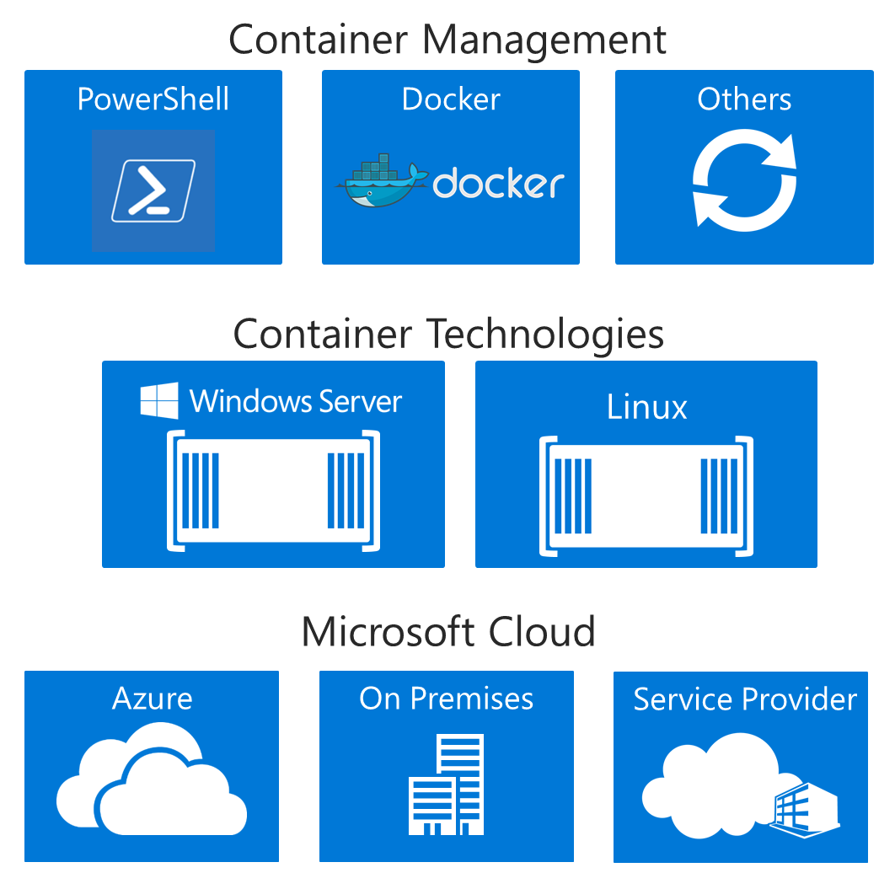
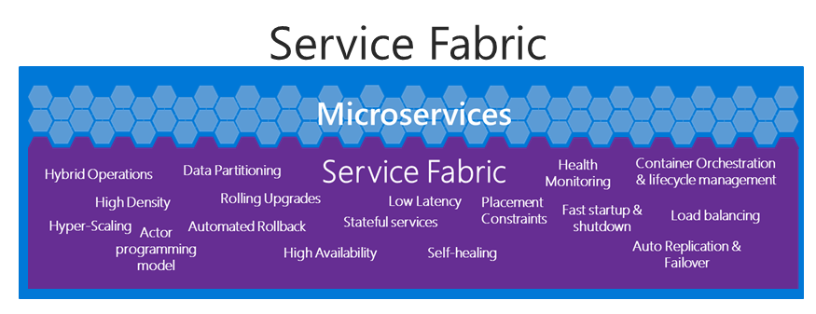
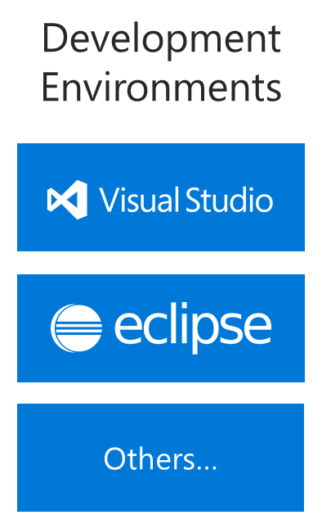
Container Tools

Slide 75
Management and Monitoring Tools
Docker Datacenter
Docker Trusted Registry
Docker Universal Control Plane
Docker Swarm
Commercially Supported Docker Engines
Docker Engine
Docker Engine
Docker Engine
Docker Engine
Docker Engine
Compute
Private Cloud
Public Cloud

Slide 76
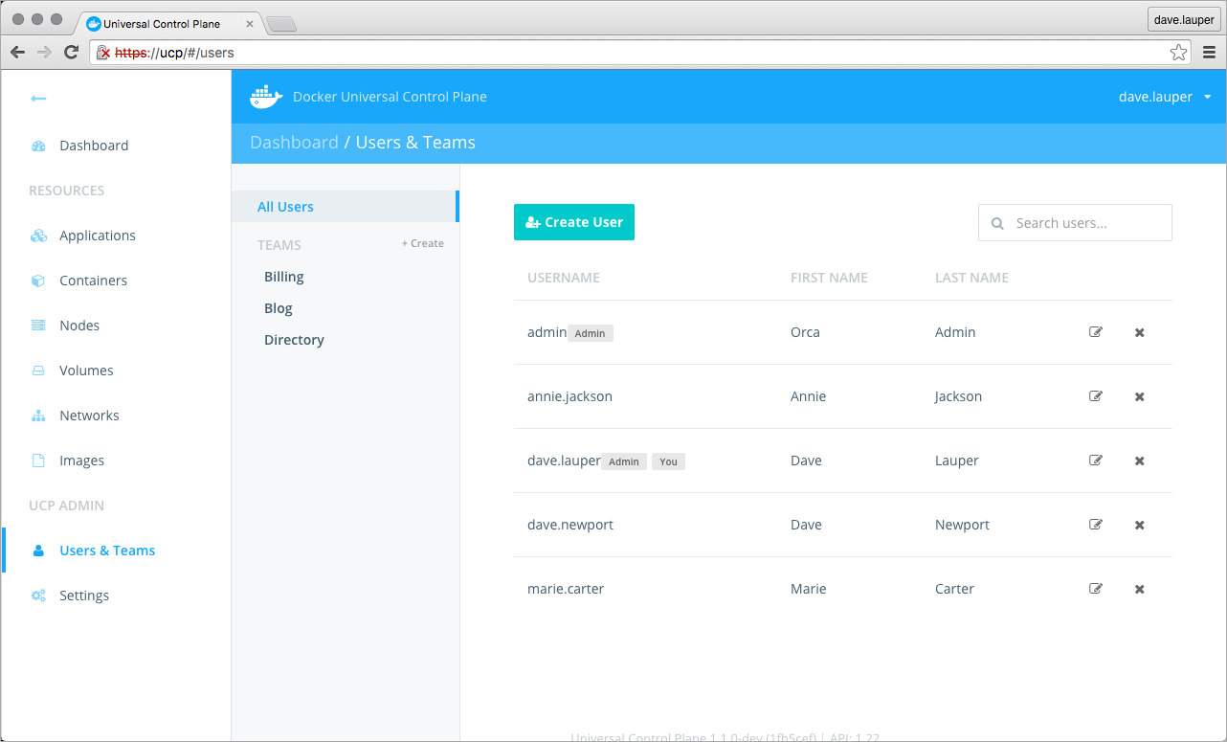
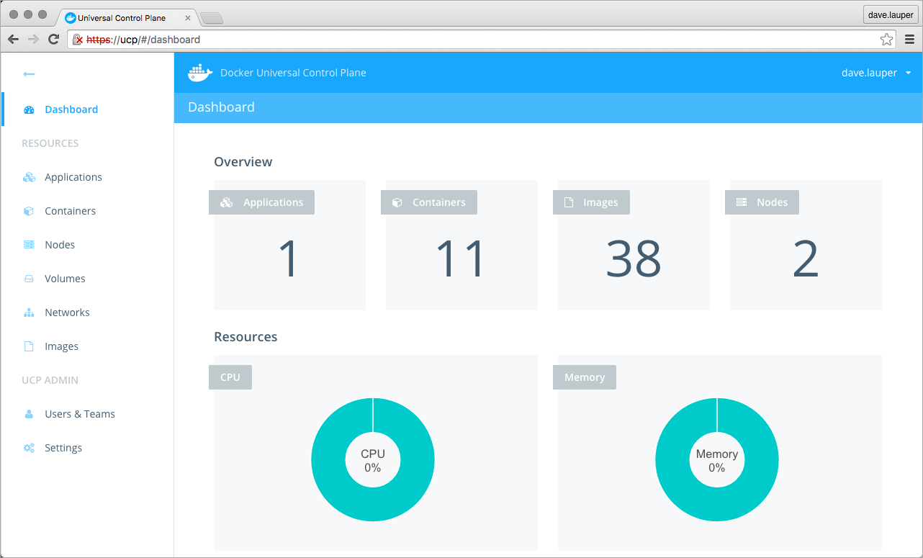
Management and Monitoring Tools
Docker Datacenter

Slide 77
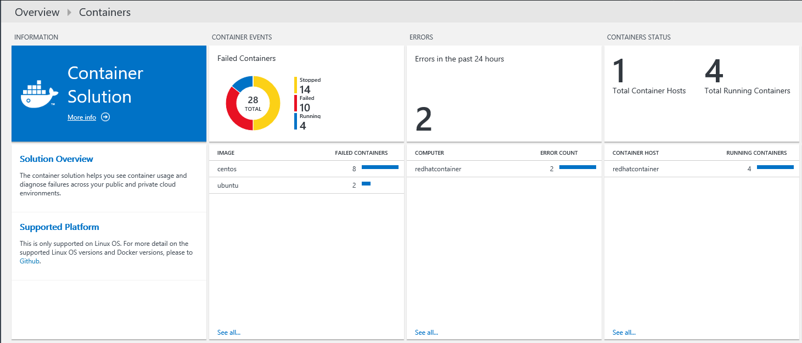
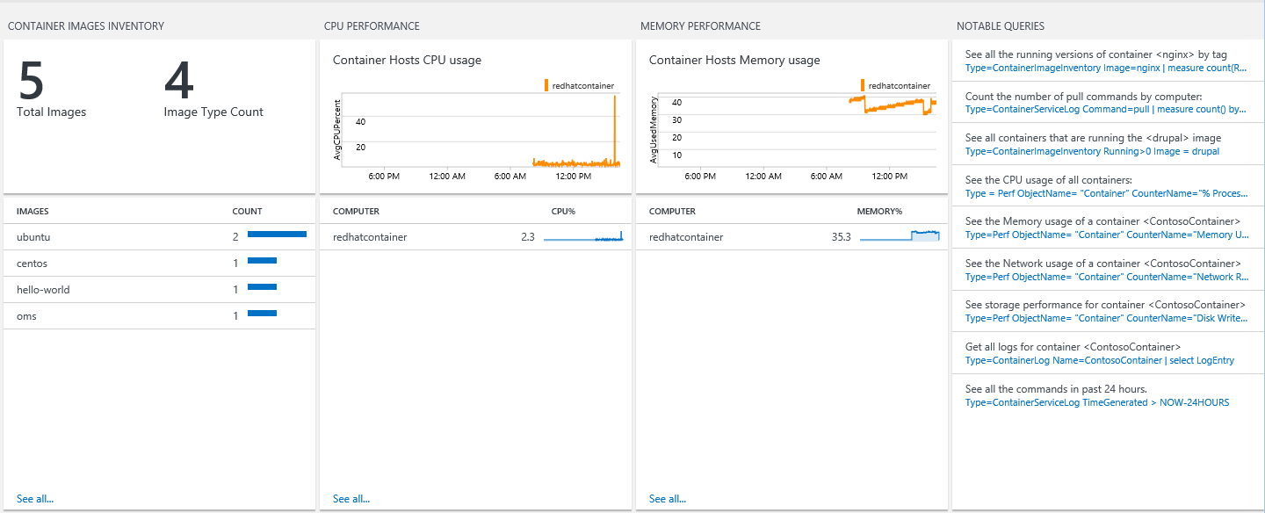
Microsoft Operations Management Suite
Monitoring Solution for Docker
Syslog events
Performance metrics
Container data

Slide 78
Build Once, Run Anywhere
using System;
class Program
{
static void Main()
{
}
}
http://aka.ms/containers

Slide 79
Thank you!

Slide 80
Demo’s & Labs

Slide 81
Lab 1
Installing Containers

Slide 82
Installing the container service
Open PowerShell in administrative mode
Install Container Service
Install-windowsfeature containers
Restart server
Restart-Computer –force

Slide 83
Install Docker
Open PowerShell in administrative mode
Create directory for Docker
New-item –type directory –path “c:\program files\docker\”
Download Docker Daemon
$version = (Invoke-WebRequest –UseBaseicparsing https://raw.githubusercontent.com/docker/docker/master/VERSION).Content.Trim()
Invoke-WebRequest https://master.dockerproject.org/windows/amd64/docker-$($version).zip –Outfile “$env:TEMP\docker.zip” -UseBasicParsing
Create environment variable for Docker
[Environment]::SetEnvironmentVariable("Path", $env:Path + ";C:\Program Files\Docker", [EnvironmentVariableTarget]::Machine)
Register service
dockerd --register-service
Start service
Start-Service docker

Slide 84
Optional – update modules
Update container modules for PowerShell
http://github.com/microsoft/Docker-PowerShell
Register-PSRepository -Name DockerPS-Dev -SourceLocation https://ci.appveyor.com/nuget/docker-powershell-dev
Install-Module Docker -Repository DockerPS-Dev
Update-Module Docker

Slide 85
Install base images
Open PowerShell in administrative mode
Install package provider
Install-PackageProvider ContainerImage –Force
Method 1 – download and install images via Internet
Install-ContainerImage -Name WindowsServerCore
Install-ContainerImage -Name NanoServer
Method 2 – download and install later
Find-ContainerImage
Save-ContainerImage -Name NanoServer -Path c:\container-image
Install-ContainerOSImage -WimPath C:\container-image\NanoServer.wim –Force
Restart Docker after image installation
Restart-Service docker

Slide 86
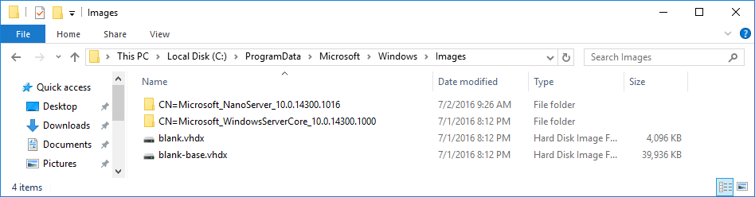
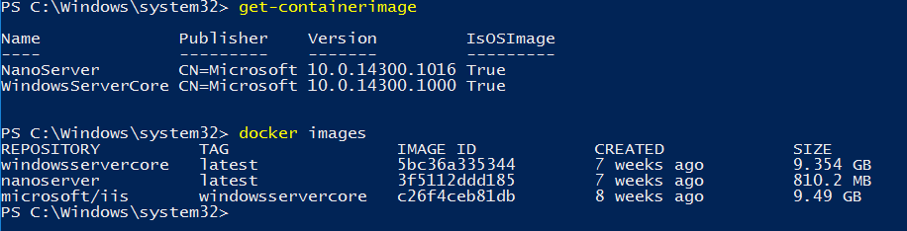
Verify installed images
Open Explorer
C:\ProgramData\Microsoft\Windows\images
Visualize using PowerShell or Docker

Slide 87
Prepare images
Add TAG for image to be used
docker tag windowsservercore:10.0.14300.1000 windowsservercore:latest
docker tag windowsservercore:10.0.14300.1016 nanoserver:latest
Visualize existent images
Docker images
Get-containerimage

Slide 88
Deploy Containers
Open PowerShell in administrative mode
Docker search Microsoft
OR
Docker search *
Downloading container
docker pull microsoft/iis:windowsservercore
Start container in background (-d), map port to host and container (-p) and execute PING to remain the container running
docker run -d -p 80:80 microsoft/iis:windowsservercore ping -t localhost
Visualize container in execution (ps)
Docker ps

Slide 89
Visualize Web Site
Verify wich IP Address used by host
Ipconfig
Use another computer on your network e type the IP Address on browser (step 1)

Slide 90
Shutdown container
Visualize container in execution and record the name
Docker ps
Remove container (rm) forcibly (-f)
Docker rm –f fervent_wright
Visualize active containers
Docker ps

Slide 91
Execute containers “on demand”
Open PowerShell in Administrative Mode
Start container in interactive mode (-it), map host port to container (-p) and visualize the command
docker run -it -p 80:80 microsoft/iis:windowsservercore ping -t localhost
Open another PowerShell in Administrative Mode and visualize containers
Docker ps
Return to the 1st PowerShell window (w/ PING command) and shutdown the container
CTRL + C
Return to the 2nd PowerShell window (w/ Docker PS command) and execute again

Slide 92
Edit content inside the container
Open PowerShell in administrative mode
Create new container and execute CMD
docker run -it -p 80:80 microsoft/iis:windowsservercore cmd
Delete default page from IIS
del C:\inetpub\wwwroot\iisstart.htm
Create new page
echo “Teste do @fabiohara" > C:\inetpub\wwwroot\index.html
Closing container session
Exit

Slide 93
Edit content inside the container (cont...)
Verify the name of the container
Docker ps –a
Create new container image (commit)
Docker commit nome_container modificado-iis
Visualize images created
Docker images

Slide 94
Optional Lab
Dockerfile

Slide 95
Syntax (example)
Iinform the container image to be used
FROM windowsservercore
Execute command (exec form or shell form)
RUN [“powershell”, “New-item”, “c:\\teste”]
OR
RUN powershell new-item c:\teste
RUN dism.exe /online /enable-feature /all /featurename:iis-webserver /norestart
RUN powershell.exe –command c:\vcredist_x86.exe /quiet
Copy data
COPY teste1.txt c:/temp/
COPY diretorio1 /sqldemo/
ADD (similar to COPY)
ADD teste2.txt c:/temp/
ADD https://www.python.org/ftp/python/3.5.1/python-3.5.1.exe /temp/python-3.5.1.exe

Slide 96
Sintax (example)(cont...)
Work directory
WORKDIR c:\\windows
WORKDIR c:\\app1\\dev
Default command to be executed during deployment of the container (exec form OR shell form)
CMD [“c:\\app1\\dev\\httpd.exe”, “-x”]
OR
CMD c:\\app1\\dev\\httpd.exe –x

Slide 97
Sintax (examples)(cont...)
Command lines to be executed via ESCAPE (character \ or `)
RUN powershell.exe -Command \
$ErrorActionPreference = 'Stop'; \
wget https://www.python.org/ftp/python/3.5.1/python-3.5.1.exe -OutFile c:\python-3.5.1.exe ; \
Start-Process c:\python-3.5.1.exe -ArgumentList '/quiet InstallAllUsers=1 PrependPath=1' -Wait ; \
Remove-Item c:\python-3.5.1.exe -Force
Using character `
FROM windowsservercore
RUN powershell.exe -Command `
$ErrorActionPreference = 'Stop'; `
wget https://www.python.org/ftp/python/3.5.1/python-3.5.1.exe -OutFile c:\python-3.5.1.exe ; `
Start-Process c:\python-3.5.1.exe -ArgumentList '/quiet InstallAllUsers=1 PrependPath=1' -Wait ; `
Remove-Item c:\python-3.5.1.exe -Force

Slide 98
Syntax (examples)(cont...)
PowerShell commands on Dockerfile
FROM windowsservercore
RUN powershell -command Expand-Archive -Path c:\apache.zip -DestinationPath c:\
REST Call
FROM windowsservercore
RUN powershell.exe -Command \
$ErrorActionPreference = 'Stop'; \
Invoke-WebRequest https://www.python.org/ftp/python/3.5.1/python-3.5.1.exe -OutFile c:\python\python-3.5.1.exe ; \
Start-Process c:\python\python-3.5.1.exe -ArgumentList '/quiet InstallAllUsers=1 PrependPath=1' -Wait ; \
Remove-Item c:\python\python-3.5.1.exe -Force

Slide 99
Syntax (examples)(cont...)
PowerShell command on Dockerfile
FROM windowsservercore
RUN powershell -command Expand-Archive -Path c:\apache.zip -DestinationPath c:\
REST call (using invoke-webrequest)
FROM windowsservercore
RUN powershell.exe -Command \
$ErrorActionPreference = 'Stop'; \
Invoke-WebRequest https://www.python.org/ftp/python/3.5.1/python-3.5.1.exe -OutFile c:\python\python-3.5.1.exe ; \
Start-Process c:\python\python-3.5.1.exe -ArgumentList '/quiet InstallAllUsers=1 PrependPath=1' -Wait ; \
Remove-Item c:\python\python-3.5.1.exe –Force
REST call (using .Net library - WebClient)
FROM windowsservercore
RUN powershell.exe -Command \
$ErrorActionPreference = 'Stop'; \
(New-Object System.Net.WebClient).DownloadFile('https://www.python.org/ftp/python/3.5.1/python-3.5.1.exe','c:\python\python-3.5.1.exe') ; \
Start-Process c:\python\python-3.5.1.exe -ArgumentList '/quiet InstallAllUsers=1 PrependPath=1' -Wait ; \
Remove-Item c:\python\python-3.5.1.exe -Force

Slide 100
Sintax (examples)(cont...)
PowerShell script on Dockerfile
FROM windowsservercore
ADD script.ps1 /windows/temp/script.ps1
RUN powershell.exe -executionpolicy bypass c:\windows\temp\script.ps1

Slide 101
Creating images via Dockerfile
Create directory to store Dockerfile
Powershell new-item c:\build\dockerfile –force
Edit Dockerfile with Notepad
Notepad c:\build\dockerfile
Create new image (using microsoft/iis:windowsservercore) and execute command
Copy and paste the following text
FROM microsoft/iis:windowsservercore
RUN echo "Hello World – teste de Dockerfile" > c:\inetpub\wwwroot\index.html
Save and close notepad
Create new image from Dockerfile
CD build
Docker build –t teste2 .
OR
Docker build –t iis-dockerfile c:\build

Slide 102
Creating images via Dockerfile (cont...)
Visualize available images
Docker images
Vsualize image dependency
Docker history name_image
Deploy new container based on image
docker run -d -p 80:80 iis-dockerfile ping -t localhost
Test: verify the host IP and open browser in another machine using this IP
Verify the name of the container in execution
Docker ps
Remove container (rm)
Docker rm –f nome_container
Extra: remove image (rmi)
Docker rmi –f id_do_container

Slide 103
Lab 2
Installing images via Docker Hub

Slide 104
Downloading images from Docker Hub
Open PowerShell in administrative mode and list available images
Find-containerimage
List images from Docker Hub
Docker search *
Download image with Apache for Windows Server Core
Docker pull microsoft/sample-httpd:windowsservercore
Download image with Apache for Nano Server
Docker pull microsoft/sample-httpd:nanoserver
List local images
Docker images

Slide 105
Optional Lab
Using VM as container Host

Slide 106
Enable Hyper-V Container in Hyper-V VM
Install VM with Windows Server 2016 TP5 and shutdown
Execute the following commands (Host)
#Name of the VM
$vm = "<virtual-machine>"
#configure the virtual processor
Set-VMProcessor -VMName $vm -ExposeVirtualizationExtensions $true -Count 2
#disable dynamic memory
Set-VMMemory $vm -DynamicMemoryEnabled $false
#enable mac spoofing
Get-VMNetworkAdapter -VMName $vm | Set-VMNetworkAdapter -MacAddressSpoofing On

Slide 107
Lab 3
Deploy Windows Containers and Hyper-V Containers

Slide 108
Prepare the Host
Verify if the host support virtualization
Mínimum 4GB RAM for labs
Windows Server 2016 TP5 or Windows 10 build 10565 (or superior)
Processor supporting Intel-VT or AMD-V
Msinfo32 to verify the processor support virtualization
Install Hyper-V role
Install-windowsfeature hyper-v
Restart server
Restart-computer -force

Slide 109
(Optional) Enable Hyper-V Container inside Hyper-V VM
Install the VM with Windows Server 2016 TP5 and shutdown
Execute the following commands (Host)
#name of the VM
$vm = "<virtual-machine>"
#configure virtual processor
Set-VMProcessor -VMName $vm -ExposeVirtualizationExtensions $true -Count 2
#disable dynamic memory
Set-VMMemory $vm -DynamicMemoryEnabled $false
#enable mac spoofing
Get-VMNetworkAdapter -VMName $vm | Set-VMNetworkAdapter -MacAddressSpoofing On

Slide 110
Using Nano Server VM to host Containers
Copy ISSO file of Windows Server 2016 TP5 locally and mount volume
Double click on ISSO file and access the directory \NanoServer
Copy the directory NanoServerImageGenerator to c:\Nano
Importe module
Import-module .\NanoServerImageGenerator -verbose
Open PowerShell in administrative mode and create Nano Server image
New-NanoServerImage -Edition Standard -DeploymentType Guest -MediaPath e:\ -TargetPath .\Nano\Nano.vhd -ComputerName Nano -containers -storage

Slide 111
Create Hyper-V VM for Nano
Create directory to store the VM (eg: c:\VM\Nano)
Copy the file Nano.VHD and paste on c:\vm\nano
Create VM with the name Nano and using the existent VHD (Nano.VHD)

Slide 112
Create Hyper-V container
Isolated mode (do not execute)
Docker run –it --isolation=hyperv nanoserver cmd
Powershell prompt will open CMD
Regular mode
Docker run –d windowsservercore ping localhost –t
Copy ID
Visualize ping process via Docker
Docker top “ID_copy”
You can see the Process ID and the command (ping)
Visualize ping process via Windows
Get-process –name ping
You can see the same process ID above

Slide 113
Create Hyper-V container (cont...)
Start container in isolated mode
docker run -d --isolation=hyperv nanoserver ping -t localhost
Copy ID
Visualize ping process via Docker
Docker top “ID_copy”
Visualize process via Windows
Get-process –name ping
The process ID will not be shown in “docker top” command
Visualize the isolated container
Get-process –name vmwp or via Task Manager

Slide 114
Lab 4
Managing data

Slide 115
Create data volumes
Execute container and create volume
Docker run –it –v c:\new-data-volume windowsservercore cmd
Create file on c:\new-data-volume
Echo “teste de volume de dados” > c:\novo-volume-dados\testevolume1.txt
Dir
Exit
Visualize volume on c:\ProgramData\docker\volumes

Slide 116
Mount data volume
Create folder on Host and copy files
Create folder c:\origem
Copy small files and paste inside this folder
Execute container mounting existing data volume on Host (c:\origem) to inside this container (c:\destino)
Docker run –it –v c:\origem:c:\destino windowservercore cmd
Command Prompt will be open
Visualize content
Using Command Prompt: enter on this folder c:\destino and visualize content (DIR)

Slide 117
Mounting single file
Create folder and test file on host
New-item -type directory –path c:\origem2
Echo “test with single file1” > c:\origem2\teste1.txt
Echo “test with single file2” > c:\origem2\teste2.txt
Echo “test with single file3” > c:\origem2\teste3.txt
Execute container and map file
Docker run –it –v c:\origem2\teste1.txt windowsservercore cmd
Visualize the directory content inside the container
Cd origem2
Dir
Inspect shared volume
Docker inspect nome_container

Slide 118
Optional Lab
Managing resources

Slide 119
Managing resources
Controlling CPU resources (1-10000, default 5000) for 2 virtual processors
Docker run –it --cpu-shares 2 –name dockerdemo windowsservercore cmd
OBS: CPU and IO still not yet supported in Hyper-V Containers
IO still not yet supported using data volume

Slide 120
Optional Lab
Nano VM using Hyper-V containers
OBS: installing new images are still not available (TBD)

Slide 121
Optional –Nano VM with Hyper-V containers
Also know as Nested Virtualization
If you want to create hyper-v containers inside Nano VM just execute the following PowerShell script:
#name of the VM
$vm = "<virtual-machine>"
#configure the virtual processor
Set-VMProcessor -VMName $vm -ExposeVirtualizationExtensions $true -Count 2
#disable dynamic memory
Set-VMMemory $vm -DynamicMemoryEnabled $false
#enable mac spoofing
Get-VMNetworkAdapter -VMName $vm | Set-VMNetworkAdapter -MacAddressSpoofing On

Slide 122
Enabling Firewall rules on Nano Server
Logon on Nano Server console and access “Inbound Firewall Rules”
Enable each rule of “File and Printer Sharing”
Press F4 to enable
Status will be “Allow”
Optional – enable remote management via WinRM
Select option “Windows remote Management” e press ENTER twice
Verify the IP address used by Nano
Select “Networking” and select “Ethernet Adapter”

Slide 123
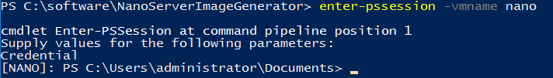
Install Docker on Nano Server VM
Nano Server TP5 not support Invoke-WebRequest
Download locally (eg: via Host) Docker Daemon and Client
Invoke-WebRequest https://aka.ms/tp5/b/dockerd -OutFile .\dockerd.exe
Invoke-WebRequest https://aka.ms/tp5/b/docker -OutFile .\docker.exe
Remote connect on Nano Server VM
Open PowerShell in administrative mode and type the following command:
Create folder C:\Docker, share and copy the content downloaded
New-item –type directory c:\docker
New-SmbShare –name DOCKER –path c:\docker
Grant-SmbShareAccess –name DOCKER –AccountName Administrators –AccessRight Full -force

Slide 124
Install Docker on Nano Server VM(cont..)
Register Docker Service on Windows
& “c:\docker\dockerd.exe” --register-service
Inicialize Docker service
Start-service docker
Install Package Provider for Windows Containers
Install-packageprovider ContainerImage –force –verbose
Download and install base image of Nano Server
Install-containerimage –name NanoServer –version 10.0.14300.1010
Obs: command is not yet available for Nano

Slide 125
Optional Lab
Configuring Docker

Slide 126
Configuring Docker on Windows
Daemon.json
C:\ProgramData\docker\config\daemon.json
If the file does not exist then you can create
Obs: not all parameters on daemon.json are valid on Docker for Windows
Enable connection to Docker daemon on TCP 2375
Option 1 – daemon.json
"hosts": ["tcp://0.0.0.0:2375", "npipe://"]
Option 2 – SC Config (via CMD.exe)
sc config docker binpath= "\"C:\docker\dockerd.exe\" --run-service -H tcp://0.0.0.0:2375"

Slide 127
Optional Lab
Remove Images

Slide 128
Remove installed images
Powershell
Uninstall-ContainerOSImage –fullname CN=Microsoft_NanoServer_10.0.14300.1016
Docker
Remove images
Docker rmi windowsservercoreiis
Remove containers
Docker rm

Slide 129
Active Directory Identity for Containers
Ready for Enterprise Applications
No infrastructure changes to Active Directory required
Leverages Group Managed Service Accounts
Enables containerized applications to authenticate with SQL Server, file shares, and more
Simple and Secure
Identity specified at container start time
Credentials are not stored within the container image
No changes required to move across environments i.e. dev, test, prod, cloud

Slide 130
Breaking down larger applications
Development
Makes development teams faster
Decoupled development, less coordination
Freedom to use the best tools for the job
Shorter builds & faster deployment
Operations
Deploy faster with automation
Reliable and deterministic
Clear list of running containers
Less risk, less downtime
Containers deliver consistency through dev, test, and production

Slide 131
Have Fun!
Quick start guide at http://aka.ms/containers

